Slide 1
Basic Statistics Final Exam Review

Slide 2
What You’ll Need to Know
Rules of probability
“and” vs. “or” probability
Variable types
Difference between a sample and a population
Sampling
Confidence intervals
z-scores
Using the normal probability applet
Hypothesis testing
Data types for graphs

Slide 3
Tips
Use your notes, the content, a buddy…
Write down your answers just in case your internet flops
Take your time

Slide 4
Rules of Probability

Slide 5
The Rules!
All probabilities are between 0 and 1
There are no negative probabilities
Total of all possible outcomes is 1
Probability of an event NOT happening:
1 – probability of the event happening

Slide 6
Variable Types

Slide 7
Quantitative / Numeric
Number
Continuous: With decimal places
Discrete: Whole number

Slide 8
Qualitative
NOT a number
Words
Categorical: Broken into groups
Ordinal: Broken into groups where ORDER MATTERS

Slide 9
Samples and Populations

Slide 10
Samples vs. Populations
Population
Sample
Larger
Use Greek letters
Mean: μ (mu)
Standard deviation: σ (sigma)
Smaller
Use Roman letters
ˉx (x bar)
S / SD

Slide 11
Parent vs. Child Distributions
Parent
Child
Larger SD
Population
Smaller SD
Same mean as the parent
Sample

Slide 12
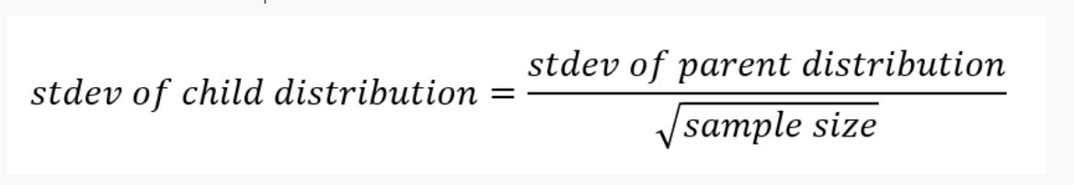


Standard Deviation of the Child (Sample)
What is the standard deviation of the sample if the sigma is 12 and your n is 444?
$$\frac{12}{\sqrt{444}}$$
$$\frac{12}{21.07}$$
.57

Slide 13
Confidence Intervals

Slide 14
What is a Confidence Interval?
Band around the mean
Your true mean falls somewhere in there
90% CI: 90% of the time
95% CI: 95% of the time
99% CI: 99% of the time

Slide 15
What is Margin of Error?
Amount you could be wrong by
Gets added and subtracted from the mean

Slide 16
Putting it All Together
Confidence Interval
Margin of Error
Margin of Error
Lower Confidence Limit
Mean
Upper Confidence Limit

Slide 17
The Larger the Interval, the More Certain
99%
95%
90%
Mean

Slide 18
z-scores

Slide 19
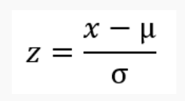
The Formula

Slide 20






An Example Working Backwards
x = 30
mu = 25
z = 3.2
What is sigma?
$$z=\frac{x−μ}{σ}$$
$$3.2=\frac{30−25}{σ}$$
$$3.2σ=\frac{30−25 ∗σ}{σ }$$
$$\frac{3.2σ}{3.2}=\frac{30−25}{3.2}$$
$$σ=\frac{5}{3.2}$$
$$σ=1.56$$

Slide 21
Using the Normal Probability Applet

Slide 22
An Example
What is the probability of selecting a value that is either smaller than 12 or greater than 18, for a distribution with a mean of 15 and a standard deviation of 2?
.13, or 13%
http://davidmlane.com/hyperstat/z_table.html

Slide 23
Data Types for Graphs

Slide 24
Categorical Only
Pie
Bar
Pareto

Slide 25
Continuous Only
Histogram
Boxplot
Scatterplot
Line graph

Slide 26
Mixed: Categorical + Continuous
Histogram with multiple groups
Side-by-side boxplots
Stacked bar graph
Data map
Tree map
Heat map

Slide 27
Questions?

